Slide 1
Electronic Word of Mouth, Brand Image, Trust and Online Utilization Intention
Dipublikasikan di Academic Journal of Interdisciplinary Studies 11(2), 355-364.
Penerbit: Richtmann Publishing
Asal negara: UK
Penulis Pertama: Dorothy R.H. Pandjaitan
Penulis Keempat/Korespondensi: Bram Hadianto

Slide 2
AJIS berdasarkan pencarian lewat www. scopus.com ➔ Percentile 45% (Q3)

Slide 3
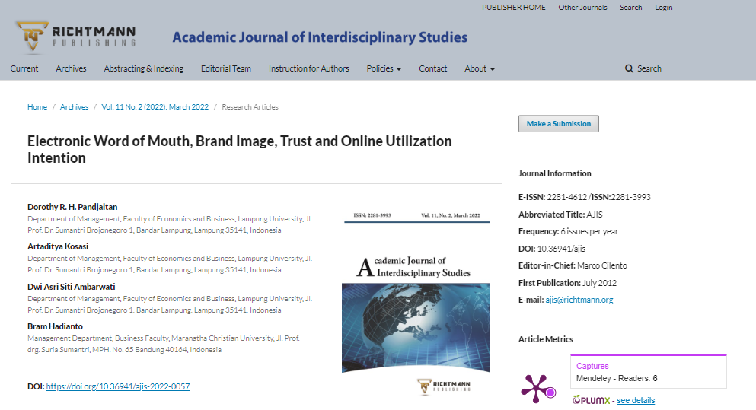
Halaman jurnal:https://www.richtmann.org/journal/index.php/ajis/article/view/12890

Slide 4
Bukti submit artikel oleh penulis korespondensi

Slide 5
Email hasil review

Slide 7
Hasil Review:

Slide 8
Hasil Review:

