Slide 1
International conference (ULICosTe 2021)
The behavior of Phosphorus Adsorption on Soil in the Geological Formation of Ranau Tuff Using the Langmuir Isothermic Model
to Support Food Security
Septi Nurul Aini¹, Wilda Yanti², Astriana Rahmi Setiawati¹, Dedy Prasetyo¹, Jamalam Lumbanraja¹
August 27th 2021

Slide 2
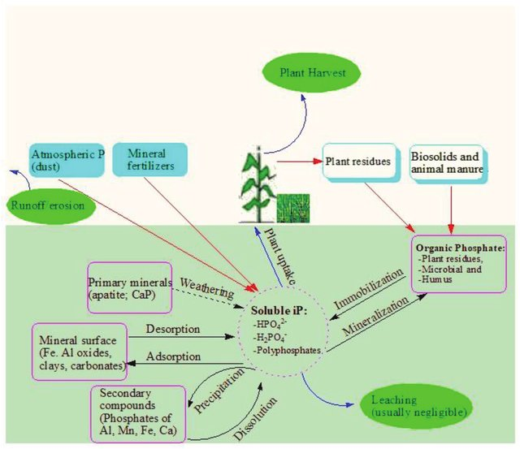
Introduction
In tropical soils => phosphorus (P) adsorption
Soils that develop from volcanic material => soil in the Geological Formation of Ranau Tuff (TRGF)
Soils which have a high capacity of P adsorption => potentially decrease the efficiency of P fertilizers for crop production
Langmuir Isothermic Model is a mathematical model that can be used to determine the capacity adsorption (X_{max}) and the relative P adsorbtion energy (K_{L}) of phosphorus in the soil.
This research is very important considering the high P sorption being not available for crops in soils developed from volcanic material and the absence of data on P sorption in the TRGF volcanic area.

Slide 3
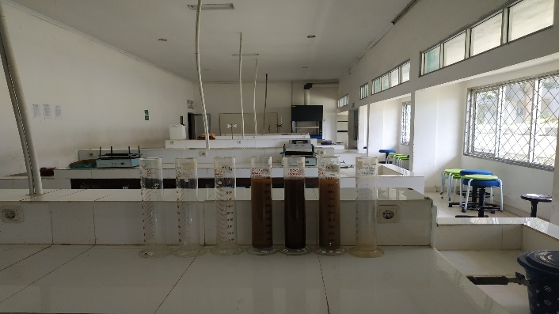
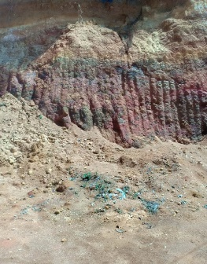
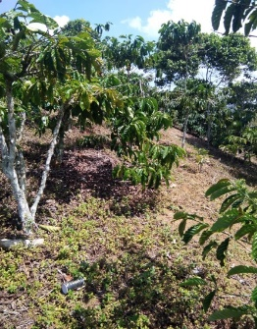
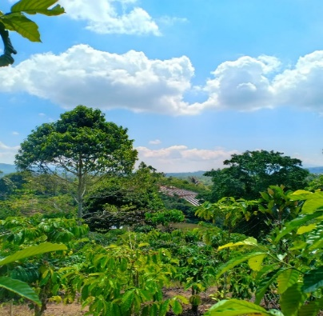
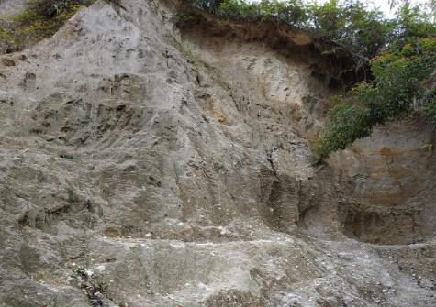
Materials and Methods
P adsorption analysis was carried out in the Laboratory of Soil Science, Faculty of Agriculture, University of Lampung
Sampling Locations:
1. Sekincau (± 40 km in the
southern area of ​​Lake Ranau)
2. Batu Brak (± 30 km in the southern area of ​​Lake Ranau)
3. Balik Bukit (± 20 km in the southern area of ​​Lake Ranau)
Soil samples were collected from two depth of soils (0 – 20 cm and 20 – 40 cm)

Slide 4
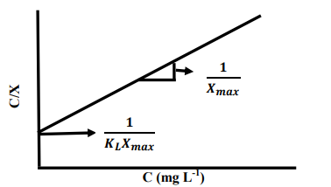
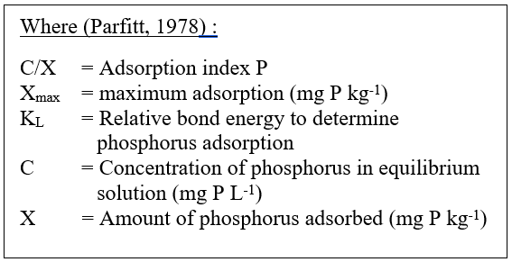
Method:
Fig. 1 Langmuir plot
Each soil sample was weighed as much as 3 g and placed into a shaker bottle (100 ml size). Then, each soil sample was added with several series of solution (0, 10, 20, 50, 100, and 200 ppm P having 10 mmol CaCl2) as much as 30 ml.
The suspension of the soil sample was shaken using a shaker for ± 2 hours.
After that, the soil sample suspension was centrifuged at 3000 rpm for 10 minutes.
The clear solution from the centrifuge was used to measure P concentration using a spectrophotometer with a wavelength of 720 nm.
While the phosphorus that was absorbed in the soil is the difference between the concentration of the original phosphorus solution given and the phosphorus in equilibrium.
The data obtained is calculated based on the equations and curves of the Langmuir equation can be seen in this Figure. 1
$\frac{C}{X}$ =$\frac{1}{K_{L}X_{max}}+\frac{1}{X_{max}}$ $C$

Slide 5
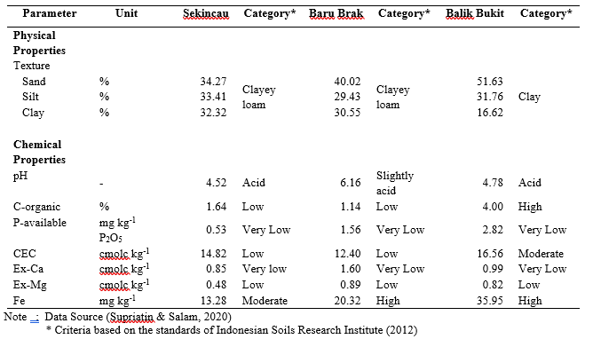
Results and Discussion
Table 1. Physical and chemical properties of the TRGF soils in Sekincau, Batu Brak and Balik Bukit.

Slide 6
Results and Discussion
Figure 2. Graph of the relationship between the amount of adsorbed P (X) and the concentration of P in the equilibrium solution (C) in the soil TRGF.

Slide 7
Results and Discussion
Figure 3. Graph of the relationship between the P adsorption index (C/X) and the concentration of P in the equilibrium solution (C) of surface and subsurface of the TRGF.

Slide 8
Results and Discussion
Table 2. Langmuir Isothermic Linear Equation Adsorption P in each sample

Slide 9
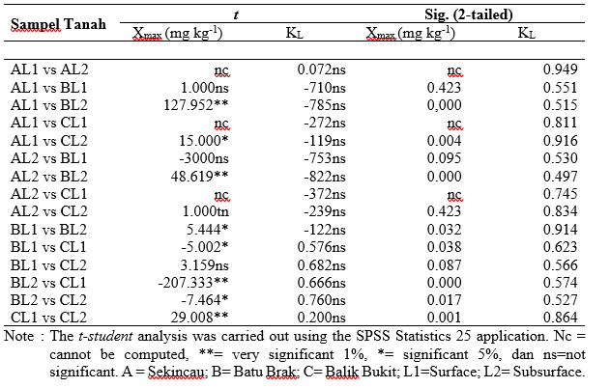
Results and Discussion
Table 3. Student-t test on maximum adsorption parameters P (X_{max}) and relative bond energy P (K_{L})

Slide 10
Conclusion
The soil in Balik Bukit has a maximum adsorption value (X_{max}) higher than that of the soil in Sekincau and Batu Brak on TRGF. The high value of X_{max} is because the soil in Balik Bukit has a high Fe content of 35.95 mg kg⁻¹, where Fe is one of the causes of high P sorption in the soil.
The K_{L} value in subsurface is relatively higher than surface so that P in subsurface is relatively difficult to be available when compared to surface, because the higher K_{L} value makes P more difficult to be available to plants. This finding is needed to be applied in field to test the fertilizer efficiency for crop production.

Slide 11
Thank you!
Any questions?
You can find me at
septi.nurulaini@gmail.com

