Slide 1
The 2nd International Conference on Applied Sciences Mathematics and Informatics August 9-11, 2018
Horison Hotel Bandar Lampung, Indonesia
Measuring of Cassava Starch Content
by Using Strain Gauge Sensor
Arif Surtono, Prima Aprilliana, Amir Supriyanto, Gurum Ahmad Pauzi,
Junaidi, Sriwahyu Suciyati and Warsito
Department of Physics, Faculty of Mathematic and Natural Sciences, University of Lampung

Slide 2
INTRODUCTION
Cassava is food substitute for rice
Has an important role in supporting national food security
Most of the cassava for food material, industry and animal feed (Widianta & Dewi, 2008)
Lampung : No. 1 Cassava production in Indonesia (2015), 7 387 084 ton (BPS-Statistics Indonesia)
Cultivation cassava plants has impact for Lampung agroindustry and community economy.

Slide 3
Introduction
Cassava tuber quality measured by starch and hydrogen cyanide (HCN) content (Cuvaca, et al, 2015)
Starch content is the most important parameter in assessment of cassava tube quality at the field.
Classical method for starch analysis : iodine-iodide (quality), gravity and redox titration (Tortajada, 2018)
Gravity method or Underwater Weight Method is the easiest method for implementation at the field
Until now, there is no instrument for starch content measurement electronically for use at the field
So…our research purpose is to design the instrument for Measuring of Cassava Starch Content by Using Strain Gauge Sensor

Slide 4
Methods
Starch content (SC) (Sungzikaw, 2008)
$SC(\%)=\frac{SG−1,00906}{0,004845}$
Specific Gravity (SG)
$SG=\frac{Ma}{Ma−Mw}$
Ma = Cassava Mass in the air (g) ;
Mw = Cassava Mass in the water (g) ;

Slide 5
Methods
Input Unit
Processsor Unit
Output Unit
Strain gauge
LCD & Laptop

Slide 6
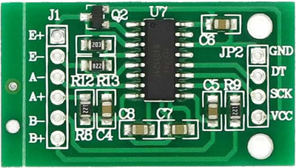
Methods
HX711 as Analog to Digital Converter (ADC). The HX711 input pin is E + as power supply, E- as ground, A- and A + as sensor data input. The HX711 output pin is the GND pin as ground to Arduino, DT as digital output, SCK as digital input, and VCC as input voltage.

Slide 7
Methods
Sensor – ADC – Arduino wiring

Slide 8
Methods
Arduino - LCD wiring

Slide 9
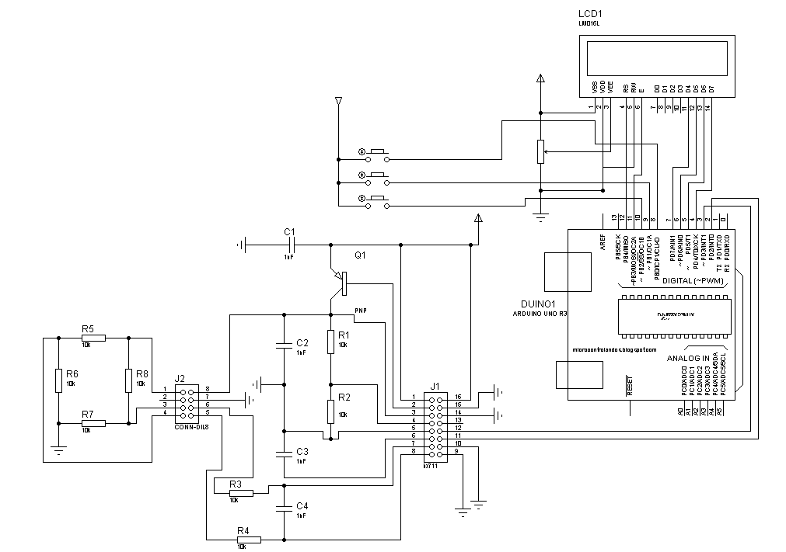
Methods

Slide 10
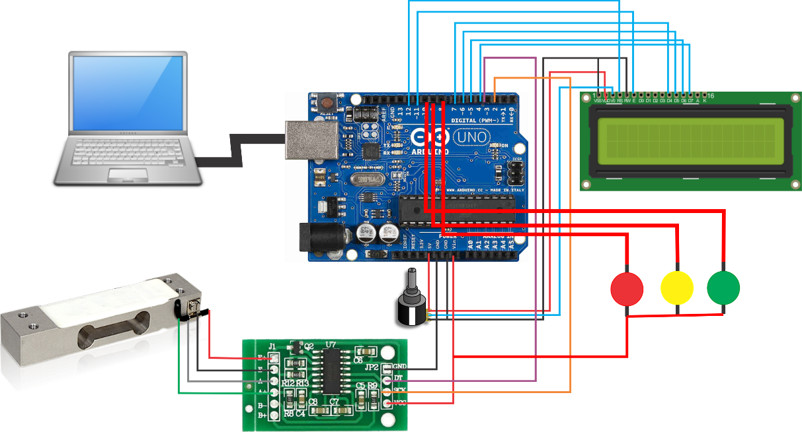
Methods

Slide 11
Methods
Jack
Water bucket
Basket
Strain-gauge
HX711
Arduino & LCD
Laptop
Physic construction

Slide 12
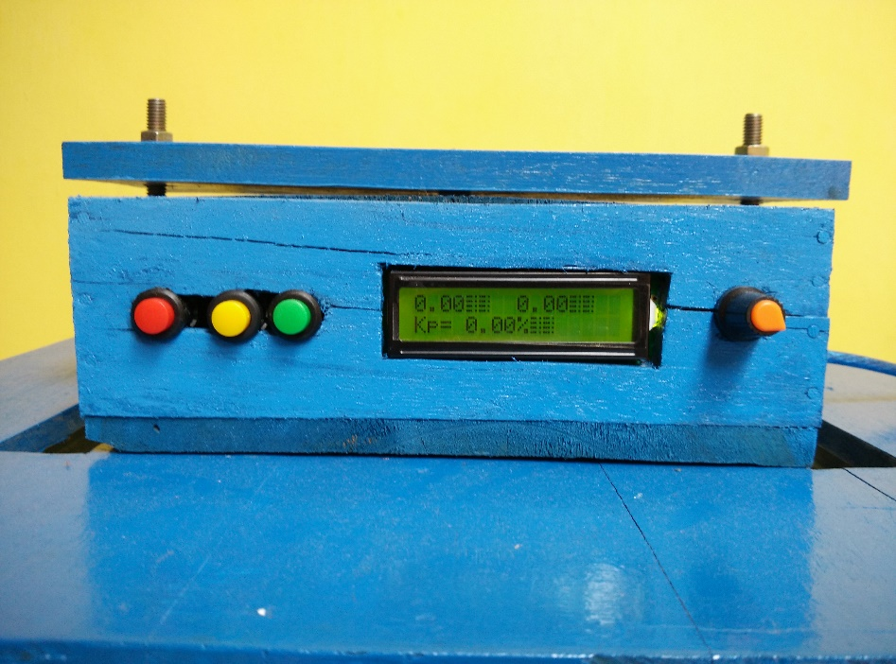
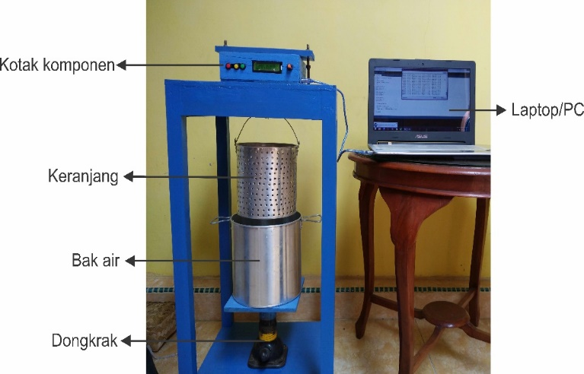
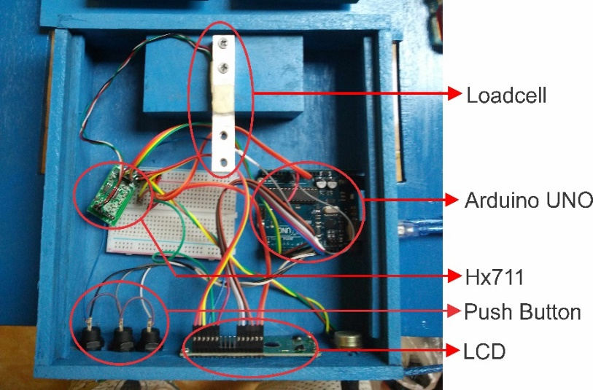
Results
Electronics
box
Basket
Water Bucket
Jack
Instrument for cassava starch content measurement

Slide 13
Results
Mass (kg) |  | Error (kg) | Error (%)
Reference | Instrument
0.000 | 0.000 | 0.000 | 0.000
0.050 | 0.050 | 0.000 | 0.000
0.100 | 0.100 | 0.000 | 0.000
0.200 | 0.200 | 0.000 | 0.000
0.500 | 0.493 | 0.007 | 1.400
0.600 | 0.598 | 0.002 | 0.333
0.700 | 0.694 | 0.006 | 0.857
0.800 | 0.788 | 0.012 | 1.500
0.900 | 0.890 | 0.010 | 1.111
1.000 | 0.985 | 0.015 | 1.500
1.050 | 1.036 | 0.014 | 1.333
1.200 | 1.185 | 0.015 | 1.250
1.500 | 1.483 | 0.017 | 1.133
1.700 | 1.679 | 0.021 | 1.235
1.750 | 1.727 | 0.023 | 1.314
2.000 | 1.976 | 0.024 | 1.200
2.200 | 2.169 | 0.031 | 1.409

Slide 14
Results
1,0 Kg samples
No | Cassava type | SC instrument (%) | SC ref. (%) | Error (%)
1 | A | 16.3920 | 16.6122 | 1.3255
2 | B | 16.1480 | 16.3560 | 1.2717
3 | C | 14.8800 | 15.0875 | 1.3753
2,2 Kg samples
No | Cassava type | SC instrument (%) | SC ref. (%) | Error (%)
1 | A | 17.0310 | 17.2762 | 1.4194
2 | B | 6.5040 | 6.6035 | 1.5072
3 | C | 20.1610 | 20.4530 | 1.4277

Slide 15
Conclusions
Strain-gauge sensor can be applied to cassava starch content measurement instrument using Arduino as processor.
The percentage of error produced by the instrument is less than 2%.

Slide 16
Acknowledgments
We express our gratitude to the Unila Research and Community Service Institution (LPPM Unila) that has funded this research in the Penelitian Unggulan 2018 with the contract number 1453 / UN26.21 / PN / 2018

Slide 17
Thanks You

